Slide 1
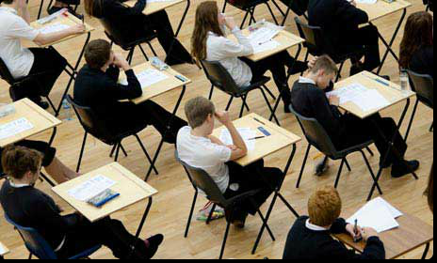
Exams
Important Information, Rules and Regulations
Mock Examinations
November 2026
Mrs Blyth, Examinations Officer

Slide 2
Timetables, seating plans and timings
Timetables
- emailed to your student email, and home, please check carefully
- master timetable on school website
Seating plans
- will be put up the day before each exam outside the Lower Hall, in the lobby area
Meeting area before exams
The car park area outside the Lower Hall, or outside your individual room, if elsewhere
Timings
10.50am and 2.20pm – with the exception of some afternoon exams which will start at 2pm, (you may leave S3 at 1.15pm for these early afternoon exams to get to the front of the lunch queue, and PE on the 26 November, starting at 9am
BTEC Sport, Child development and Food exams have been rescheduled to a later date
end time may be before the end of a lesson, in which case you return to lesson, or may be slightly after the end of school, particularly if you have extra time
Mobile Phones
These should all now be in your tutor room lockers. If you think you will finish after the end of school on any day, please leave with Reception in the lockers provided there

Slide 3
Mock Exam Rules and Regulations
-These Exams will be run under the same rules and conditions as your Summer GCSE exams.
-In the unlikely event that exams are cancelled again these mock exam results may go towards a Teacher Assessed grade. These results will also be used for predicted grades
-Any behaviour that could be interpreted as disruptive or involve cheating could jeopardise these results, and may be reported to the Exam Board – it is IMPORTANT you get these exams right – if you disrupt an exam you disadvantage other students around you, and that is UNFAIR

Slide 4
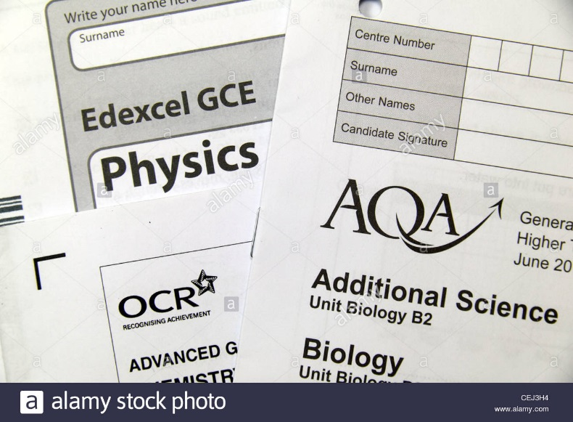
At the start of the exam
Get everything you need for the exam out of your bag before you enter the exam room. Your bag (with watches etc) must be placed in the allocated area away from your desk.
You must enter the exam room in silence
Listen to and follow any instructions given by the invigilator
Check you have the correct paper, but do not open until told to do so
Read the instructions on the front of the exam paper carefully
Fill in your details, including your teacher’s name on the front of the exam paper or answer booklet only when told to do so
Notes:
Pay attention – this may be the last chance to sort out problems before the exam begins

Slide 5
Additional important Information that you need to know………….

Slide 6
Exam Access arrangements - reminders
Extra time – you are encouraged to use it, you may be asked to change to a red pen when in extra time, may take you past the end of the school day (blue card on desk)
Rest breaks – hand up, paper taken away and clock stopped, paper given back at end of rest break (taken at desk unless otherwise agreed, maximum 10 minutes) and time added on to end of exam (orange card on desk)
WP users – remember to save your work and select ‘print’ and come to the office to check and sign your work
Reading pens – will be on your desk at the start of exam for you to use as needed, headphones provided
Ear plugs – must be non-electronic (and pre-agreed)
Prompter – Invigilator may tap on the desk or give you a ‘time remaining’ reminder
Computer readers - set up in advance and available for reading your exam papers, come to the exams office if you would like refresher training on how to use
If you do not feel your exam access arrangement is in place for a particular exam – put your hand up!

Slide 7
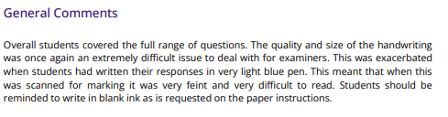
Feedback from the GCSE examiner for 2025/26

Slide 8
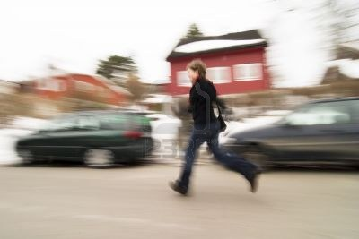
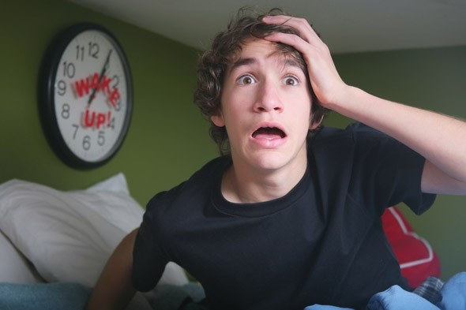
Don’t be late and come prepared
Check your timetable carefully for the start time and the rooming details.
Arrive at least 10 minutes before the start of each exam, with all equipment you need

Slide 9
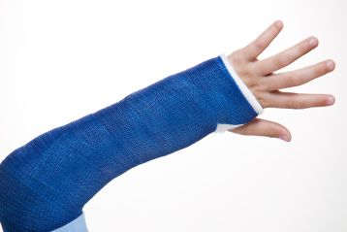
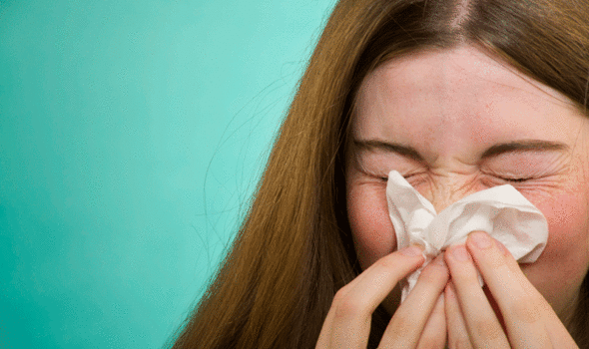
Notify the School if you are unwell or have an injury
If you are ill on the day of your exam your parent or carer must telephone the school and report your absence in the usual way
We may need to make alternative arrangements for you to sit the exam on a different day

Slide 10
Additionally………..
You will be expected to be in the correct school uniform, coats may not be worn
Toilet breaks will not be allowed
Exam desk labels will include student photos, to help you and invigilators identify your seats more quickly, and to meet exam board guidelines on being able to identify students.

Slide 11
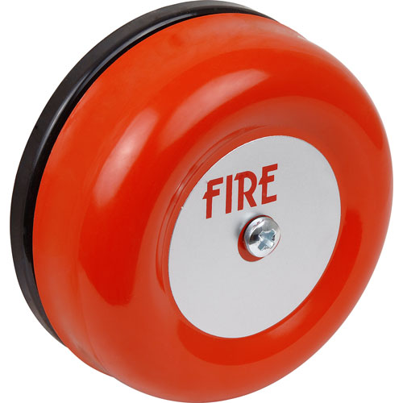
No. 10 – Be aware of the emergency procedures…
Follow the instructions given by the invigilator, your evacuation place will be different to where you would go to on a normal school day. It will be in the rear staff car park, or on the grassed area outside the Lower Hall if you are in a different exam room to the Dome
You must not talk to other candidates
If instructed to evacuate you should leave all personal belongings and exam material in the exam room

Slide 12
Any questions or concerns?
Please come and talk to us in the Exams Office (located near Reception), and don’t leave it until the last minute!

Slide 13
Please watch the video in the link below this presentation carefully as there is important information you will need to know

