Slide 1

A student guide to exams
2025/2026 academic year

Slide 2
Exam regulations
Before the exam
You need to know which exams you have been entered for, and when they take place
During the exam
You need to know the rules you need to follow in the exam room
After the exam
You need to know when and how you will receive your results, and what to do if you think an error might have been made with your grade(s)
The awarding bodies have a set of rules which all candidates must follow when taking their exams

Slide 3
Exam entries
You will be provided with information about the exams you are taking in the form of a Candidate Statement of Entry and an Exam Timetable
Entry information Tell the exams officer if… | Exam day arrangements Be aware of… | Exam clashes Ensure that…
You think you have been entered for an incorrect exam | The date of your exams | You check your timetable for any exam clashes
You have not been entered for an exam which you think you should be sitting | The time of your exams | Your exams officer explains what happens if you have two or more exam papers timetabled at the same time
Your personal details are incorrect | The rooms in which your exams will be taking place | You ask your exams officer if you are unsure what to do if you have a timetable clash

Slide 4
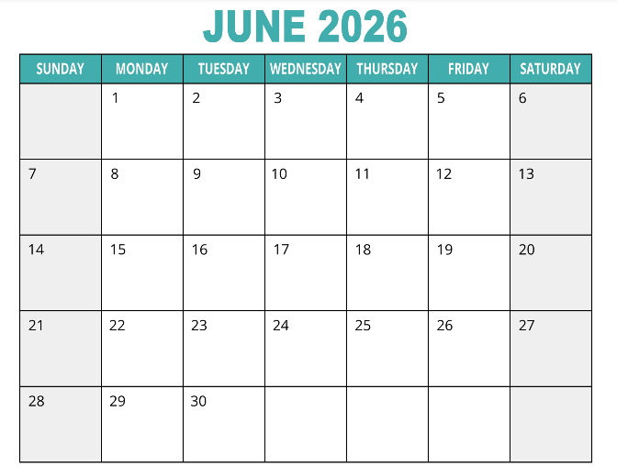
Contingency day: 24 June 2026
Until you have completed all of your examinations, you must make sure that you are available on 24 June 2026
This is the contingency day in the event of national or significant local disruption to examinations in the United Kingdom

Slide 5
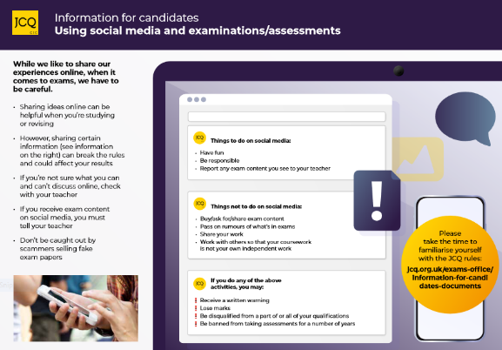
Social media
Do not:
Buy/ask for/share exam or assessment content
Pass on rumours of what’s in exams or assessments
Share your work
Work with others so that your assessment is not your own independent work
If you do, you may:
Receive a written warning
Lose marks
Be disqualified from a part of or all of your qualifications
Be banned from taking exams and assessments for a number of years

Slide 6
The exam day
Before you take your exams, your must be aware of…
The room(s) in which your exams will be taking place, and where to meet before the exam
The time each of your exams will be starting (and finishing) and how long before the exam you should arrive at your designated meeting point (10 minutes)
Morning exams start at 9.15am
Afternoon exams start at 2.00pm
Where you will be seated during each exam, and where you can check your room and seating
Where your personal belongings will be kept, for example your bag, mobile phone etc.

Slide 7
What you must do if you are late for an exam
Step 1: Telephone the school Reception, make sure you have the number stored in your phone
Step 2: Switch off your phone and any other communication device
Step 3: Where possible, you should arrange to be brought into school by your parent/carer or another responsible adult who should be given your switched off phone, and they should accompany you in to Reception at which point your phone should be given to Reception staff, while Reception call the exams officer
Step 5: Your exams officer will escort you to your exam room and give you the full instructions for the exam, and answer any questions, before you are allowed to begin your exam
You must be on time for all of your exams
However, if you are/you think you will be late for an exam, follow these five steps

Slide 8
What you must do if you are ill on the day of an exam
Step 1: Telephone the school reception and ask to speak with the exams officer, as well as reporting it on the absence line in the normal way
Step 2: Follow the instructions given by the exams officer, (there may be some situations when you may still be able to attend but additional arrangements may be put in place for you)
Step 3: Get evidence to prove your illness (e.g. a doctor’s note)
Step 4: You should continue to follow this procedure if ill for more than one day, and then should arrange to see the exams officer on your return
If you are feeling unwell on the day of an exam, follow these steps

Slide 9
Access arrangements
You will be informed ahead of the exam of how your access arrangement(s) will be delivered on the day of the exam
Before the start of the exam, the invigilator will ask you to check that you have the expected access arrangement(s) and that if there is a problem, to put up your hand to attract the invigilator’s attention
Access arrangements could include:
Extra time
Reader/computer reader or reading pen
Scribe
Supervised rest break
Prompt

Slide 10

Exam room posters: Unauthorised items
You are not allowed to bring the following into the exam room as they are potential technological/web enabled sources of information:
Earphones or earbuds (e.g. AirPods)
Mobile phones
MP3/4 players or similar devices
Smart glasses
Tablets (e.g, iPads or iPods)
Watches
Any other smart devices

Slide 11
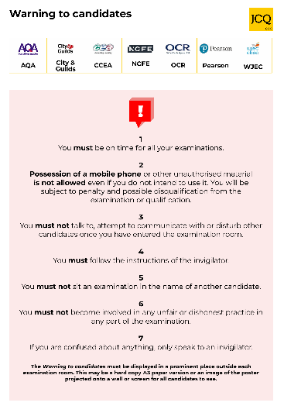

Exam room posters: Warning to candidates
In particular, note the following:
Possession of a mobile phone, even if you do not use it, is not allowed and may be subject to penalty, including possible disqualification
You are under formal exam conditions from the the moment you enter the room in which you will be taking your examination(s) until the point at which you are permitted to leave
You must follow the instructions of the invigilator
Remember:
If you do not follow these instructions, you are committing malpractice

Slide 12



Formal examination conditions
Formal examination conditions are:
You are under formal examination conditions from the moment you enter the exam room until the point at which you are permitted to leave and are outside the exam room
If you talk to, communicate with, or disturb other candidates as you enter the exam room, you will be reported to the awarding body who will decide whether to penalise you which may include disqualification
Additionally, you should ensure you arrive for all exams on time and in the correct school uniform with only the equipment needed for your exam, and everything else, including switched off phones, put away in your bag
No communicating with other candidates
No disturbing other candidates
No talking to other candidates

Slide 13


The role of the invigilators
Each exam room will have at least one invigilator
The invigilators are following the rules set by the awarding bodies
The lead Invigilator (or Exams Officer) will give out the announcement at the start of each exam, ask you to check you have the correct paper, and give you the opportunity to ask any questions or let them know if you are missing your access arrangements
Invigilators will record any irregular incidents which occur in the exam room (e.g. if someone feels unwell, requires the toilet or falls asleep, etc.)
If you behave in a suspicious manner the invigilator will approach you and ask you to stop
If you misbehave, the invigilator will warn you that you may be removed from the exam room
You are committing malpractice if you do not follow the invigilator’s instructions, and you will be reported to the awarding body
Remember:
If you do not follow these instructions, you are committing malpractice

Slide 14
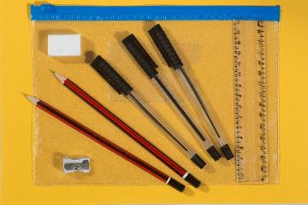
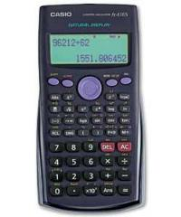
Bring the correct equipment
Only use black pens
Erasable pens are not permitted
Only clear pencil cases are permitted
Clear anything stored in your calculator, and put your lid away in your bag
No notes, revision books, calculator lids/instruction leaflets or any digital equipment or fidget toys unless an authorised exam access arrangement

Slide 15
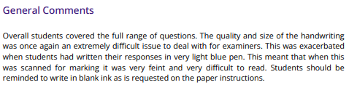
This comment was made by an examiner in their report on the 2024/25 GCSE examinations

Slide 16

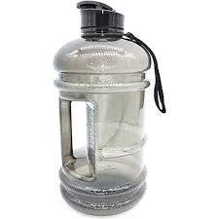

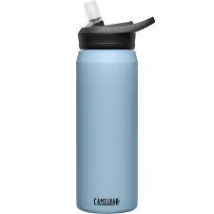
Drink bottles
The invigilator may ask you to take off the lid if this is large enough to hide notes
Drink bottles must be transparent with all labels removed
This includes transparent, reusable plastic bottles

Slide 17











Unauthorised materials
The following are defined as unauthorised materials and items and cannot brought into the exam room:
An unauthorised memory stick
Notes, or revision data, enclosed within or written on the pages of a bilingual dictionary
Notes (including those in the wrong format or prohibited annotations), study guides and personal organisers
Mobile phones
Earphones/earbuds (e.g. AirPods)
Pencil cases which are not see-through
Any other smart devices (e.g. smart watches)
Tablets
(e.g. iPads, iPods)
Watches
Smart glasses
MP3/4 players or similar devices

Slide 18
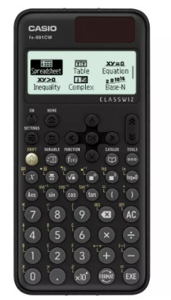

Using calculators
It is the responsibility of candidates for making sure that their calculators meet the awarding bodies’ regulations
During an exam, a calculator must not give access to pre-stored information or facilities. This includes:
Databanks
Dictionaries
Mathematical formulae
Text
Language translators
Symbolic algebra manipulation
Symbolic differentiation or integration
Communication with other machines or the internet
The instructions on the question paper will say whether calculators are allowed or not. If the instructions do not include such a statement, calculators should be treated as standard equipment and may be used by candidates
Your Maths teacher will explain how a calculator can/cannot be used in an exam
A calculator must not be borrowed from another candidate during an examination, but an invigilator may give a candidate a replacement calculator

Slide 19

Emergency evacuation of the exam room
If there is an emergency, such as a fire alarm, the exam room will be evacuated
You must follow the invigilator’s instructions
If we need to evacuate your exam room, your Invigilator
will pause the exam and instruct you to close your
exam paper, leave all belongings and evacuate,
in silence, to the evacuation point, where you
will remain under exam conditions, in silence

Slide 20
Malpractice
Offence | Warning | Loss of marks on that paper | Loss of marks on all papers in that subject
Bringing notes in the wrong format or prohibited annotations into the exam room | Notes/annotations go beyond what is permitted but do not give an advantage; content irrelevant to subject | Notes/annotations are relevant and give an unfair advantage | Notes/annotations introduced in a deliberate attempt to gain an advantage
Mobile phone or similar electronic devices (including iPod, MP3/4 player, memory sticks, smartphone, smartwatch, AirPods, earphones and headphones) | Not in the candidate’s possession but makes a noise during the examination | In the candidate’s possession but no evidence of being used by the candidate | In the candidate’s possession and evidence of being used by the candidate

Slide 21
Malpractice
Offence | Warning | Loss of marks on that paper | Loss of marks on all papers in that subject
A breach of the instructions or advice of an invigilator, supervisor, or the awarding body in relation to the exam rules and regulations | Minor non-compliance: e.g. sitting in a non-designated seat; continuing to write for a short period after being told to stop | Major non-compliance: e.g. refusing to move to a designated seat; significant amount of writing after being told to stop | Repeated non-compliance
Disruptive behaviour in the examination room or assessment session (including use of offensive language) | Minor disruption lasting a short time; calling out, causing noise, turning around | Repeated or prolonged disruption; unacceptably rude remarks; being removed from the exam room; taking another’s possessions | Warnings ignored; provocative or aggravated behaviour; repeated or loud offensive comments; physical assault on staff or property

Slide 22
Malpractice
Offence | Warning | Loss of marks on that paper | Loss of marks on all papers in that subject
The inclusion of offensive or obscene material in scripts, controlled assessments, coursework, non-examination assessments or portfolios | Isolated offensive words or drawings | Frequent offensive words or drawings; isolated obscenity or offensive comments directed at an individual or group | Frequent obscenities; discriminatory language, remarks or drawings directed at an individual or group
Copying from another candidate or allowing work to be copied (including the misuse of technology) | Lending work not knowing it would be copied | Permitting examination script/work to be copied; showing other candidates’ answers | Copying from another candidate’s script, controlled assessment, coursework, non- examination assessment; borrowing work to copy

Slide 23

Leaving the exam room
The only time a student will be allowed to leave the exam room (and this will always be with supervision) during an exam is in the case of an emergency (for eg medical)
Toilet breaks, unless there is an agreed medical reason, will not be allowed, as they are very disruptive to other candidates
You will not be allowed to leave the exam before the official end time
If you choose not to use your extra time, whilst we would encourage you to do so, you will be allowed to leave the exam room when you are finished, as long as it is after the official finish time
If you leave unaccompanied at any time during the exam, you will NOT be allowed to come back in to the exam

Slide 24

Results
Results day this year is Thursday 20 August 2026
Results will be available to pick up from school from 9am, and will be published
on Go4Schools at 10.00am. There will be staff on hand to assist on results day, asd we encourage you to come in and pick them up from school

Slide 25
Reviewing your result(s): Your options
Access to scripts | Service 1: A clerical re-check | Service 2: Review of marking | Service 3: Review of moderation
This allows you and your teacher to view your exam script before deciding whether an enquiry about your result(s) should be submitted to the awarding body | This includes a check that: all parts of your script (your answers) have been marked marks have been totalled and recorded correctly | This includes: a review of the original marking to ensure that the mark scheme was applied correctly, and to correct any errors a check that all parts of your script (your answers) have been marked, and that marks have been totalled and recorded correctly | This applies to non-examination assessments and coursework and includes a review of the original moderation and sample of candidates’ work to ensure that the assessment criteria was applied fairly, reliably and consistently (this service is not available to individual candidates)

Slide 26
Requesting a post-results service
Details of how to request a post results service will be included in your results envelope

Slide 27

Certificates
Certificates will be sent to schools in November, and a time will be arranged for
you to come in to collect these
If you are not available to come in to pick these up, you can opt for them to be
sent to you, but there will be a postage cost for you to pay
Any certificates not collected and not requested to be posted will be kept by
the exams team, and then securely destroyed one year later

Slide 28
Questions
This presentation (including the video) will be put on the exams page of the school website for any information that you want to check again, and for any students who have missed the assembly, or parents/carers who wish to view it
Any other exam related questions, please come, sooner rather than later, to the exams office where we will be very happy to help

Slide 29
….and finally
Remember, it is only just over two weeks now until the first exam day!!
GOOD LUCK!!!!
Play the Instructions for candidates (2025/2026) video: https://youtu.be/SFhmWQazIAk

