Slide 1


Year 7 Success Evening
10 September 2025
A copy of this presentation will be made available on the ‘Joining Us’ section of our website

Slide 2
Introductions
Deri O'Regan
Headteacher

Slide 3
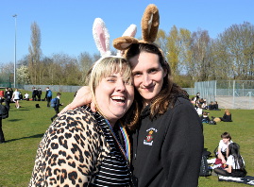
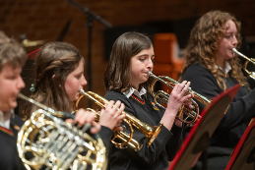
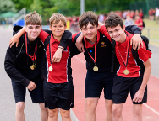

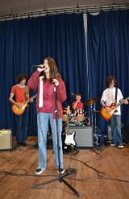
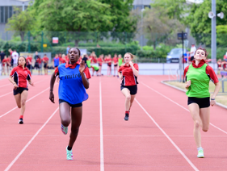
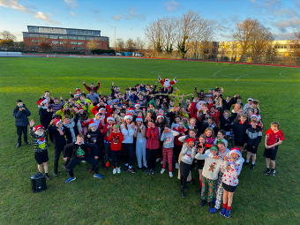
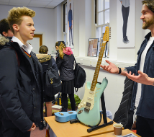
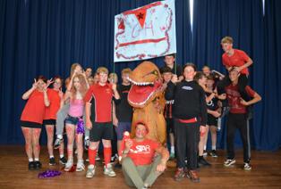
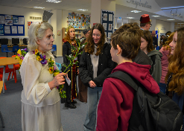
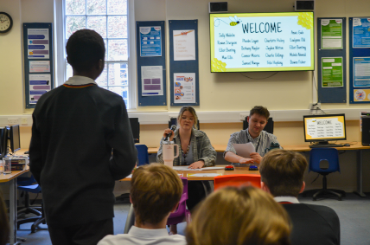
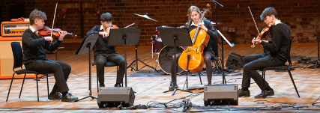
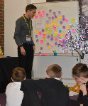

Slide 4
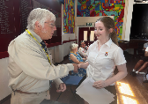
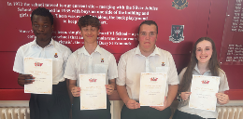
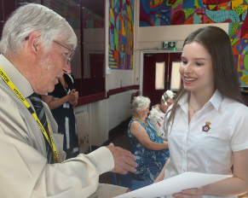
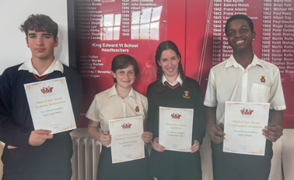
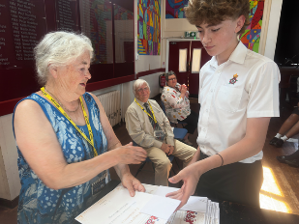
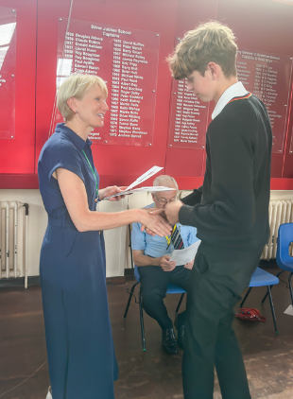
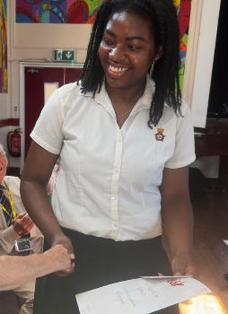
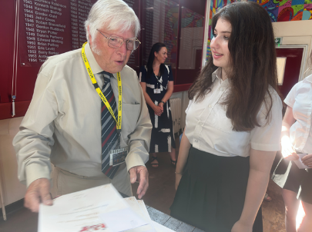

Slide 5

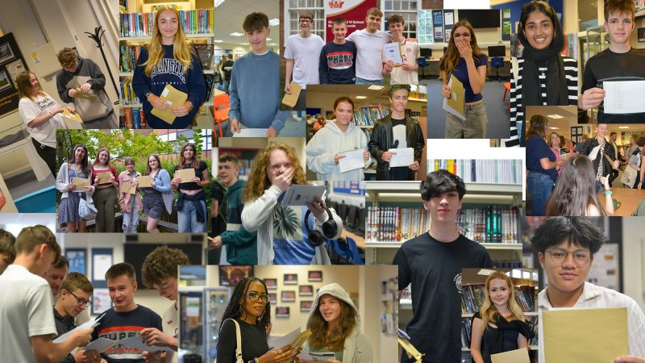
Year 11 Success
Meral 9 9 8 8 8 8 7 7 7 7 6
Claudia 8 8 8 8 7 7 7 7 7 7
Isla 9 9 8 8 8 8 8 8 8 8 8
Evie 9 9 9 8 8 8 8 8 7 7
Angus 9 9 8 8 8 8 8 8 7 7 7
George 9 9 8 8 8 8 8 7 7 7
Dorothy 9 9 9 9 9 9 8 8 8 8 7
Jack 9 9 9 9 9 9 9 9 8 8
Bronwyn 9 9 9 8 8 8 8 8 8 7
Lara 9 9 9 8 8 8 7 7 7 7
Harry 9 9 9 9 9 8 8 8 8 8 7
Amias 9 8 8 8 8 7 7 7 7 7
Jared 9 8 8 7 7 7 7 7 7 7 6
Megan 9 9 9 9 9 9 9 9 9 8

Slide 6
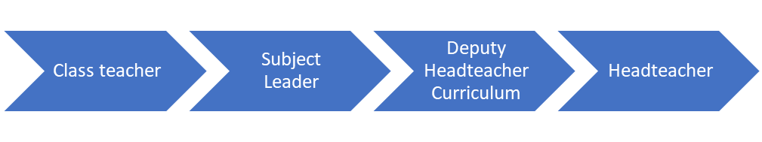
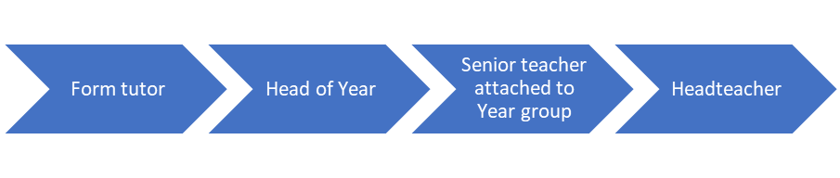
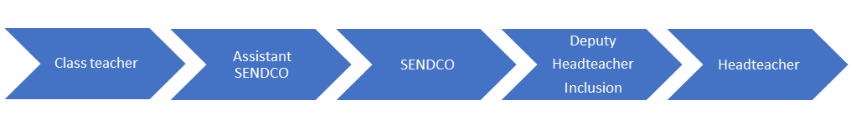
Parent contact
Is it an academic enquiry?
Is it a pastoral enquiry?
Is it a SEND enquiry?
Is it a safeguarding Concern?
Every adult is trained to pass on a safeguarding concern in the appropriate way. We also have a safeguarding button on the website which is monitored by our DSL and full time Safeguarding Officer.

Slide 7


Slide 8
Reports to parents
21st November | Rotation 1 report DT/FOOD/PA/PSHE
27th November | Year 7 parents evening
13th February | Full report + rotation 2 report DT/FOOD/PA/PSHE
15th May | Rotation 3 report DT/FOOD/PA/PSHE
12th June | Full Report
16th July | Rotation 4 report DT/FOOD/PA/PSHE
Attitude to learning + attainment

Slide 9
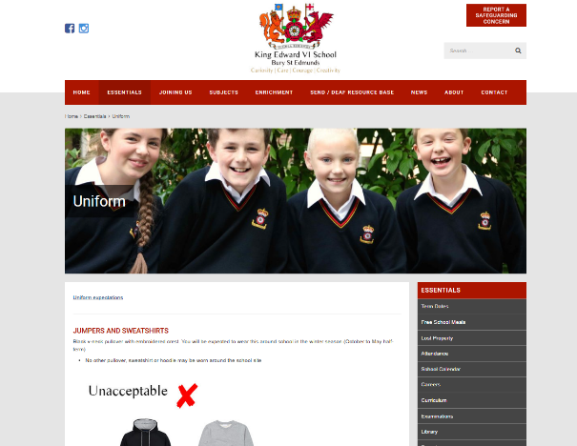
Uniform

Slide 10


Mobile Phones

Slide 11
The Role of the Head of Year and the PSM
Chesney Ward and Hannah Scarlett
year7@king-ed.suffolk.sch.uk
Michaela Organ
on@king-ed.Suffolk.sch.uk
Pastoral care
Monitoring behaviour and progress
Supporting your child to succeed
Safeguarding
Attendance

Slide 12


Slide 13

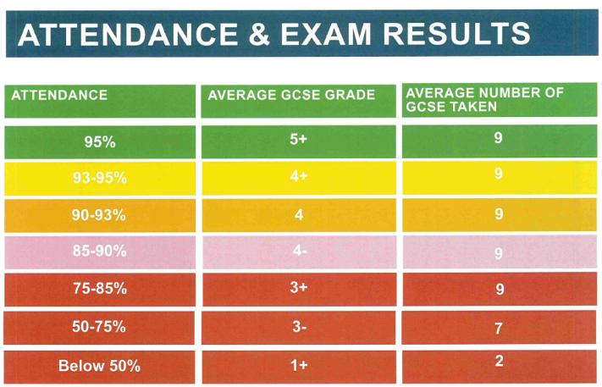
Attendance

Slide 14
KS3 English
How to support your child with English at Secondary School
Miss Reynard
Email RD@King-ed.Suffolk.sch.uk

Slide 15

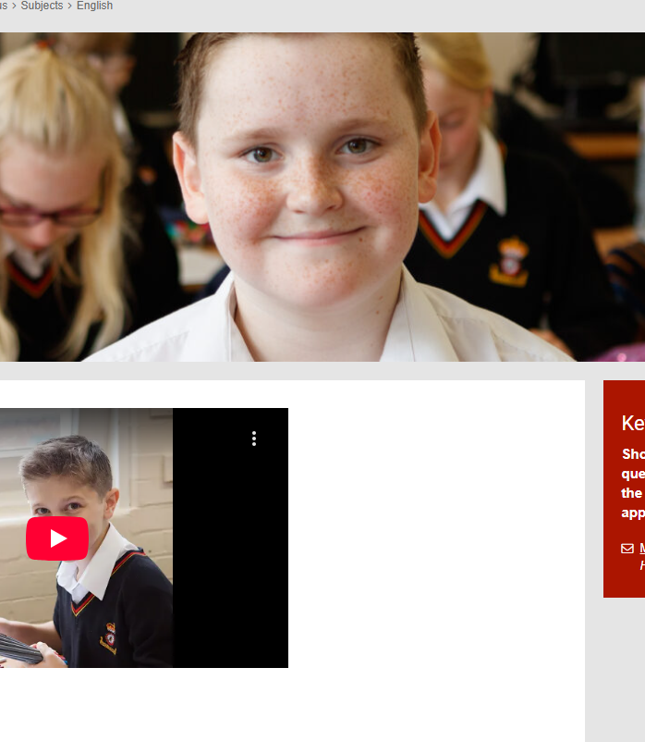
What do students study at KS3?

Slide 16

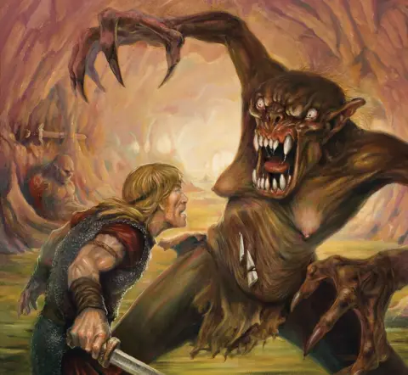
Start with:

Slide 17
Vocabulary: Talking at home!
Literacy is defined as the foundational skills that provide the base on which to:
  read and write,
  speak, listen and interact,
  and really think about complex ideas.
You can help your child in English, and all subjects, by finding time to talk to them.
Look at the key words in their knowledge organisers (available on the school website) and find ways to bring that word into conversation at home.
Ask students to explain ideas or concepts to you that they have been studying in class.

Slide 18
Alex Quigley – R.E.A.D.Y talk
Recall past events
Explain new words and concepts
Ask lots of questions
Discuss the future
You can make a difference!
Mother: Look at that bird over there.
Child: I see it.
Mother: Do you remember what the bird did at the zoo last week?
Child: It flew right in front of us.
Mother: Yes. And do you remember what the zookeeper said about the bird?
Child: Its bones were hollow.

Slide 19

Extended Writing Strategies
Planning
Independent proof-reading
→ capital letters
→ spellings
→ punctuation
→ sentences
→ paragraphing (TiPToP)
→ vocabulary
Any students interested in contributing to the school magazine should contact Miss Warner (WA@king-ed.suffolk.sch.uk). Opportunities include non-fiction article writing, art, photography, creative writing, and poetry.

Slide 20
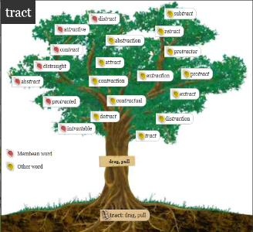
Spelling Strategies
Break it into sounds (Wed-nes-day)
Break it into syllables (re-mem-ber)
Use mnemonics (necessary = 1 Collar, 2 Sleeves)
Refer to a word in the same family (muscle ~ muscular)
Words within words (a rat in speARATe)
Refer to etymology (bi + cycle = two + wheels)
Apply spelling rules e.g. doubling consonant for short vowel (writing, but written)
Learn by sight (look, cover, write, check)

Slide 21
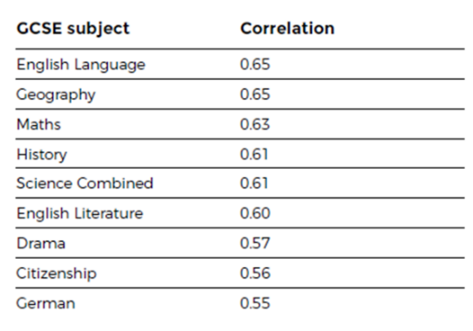
The importance of reading:
Reading regularly is not just important for your child to do well in English, but vital for them to succeed throughout their schooling and is a key life skill.

Slide 22


Why read with your child?
It’s OK for you to be a learner too!
Did you know that the average reading age for a GCSE exam paper is 15.8 years?
To give your child the best possible chance of succeeding in their exams, we need to support them in matching or even exceeding this reading age.

Slide 23
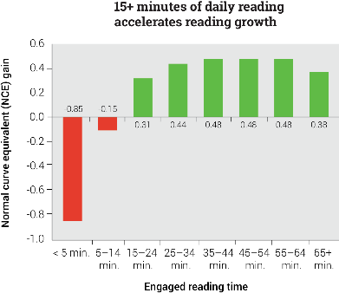
Benefits of increased daily reading:
An analysis comparing the engaged reading time and reading scores of more than 2.2 million students found that students who read less than five minutes per day saw the lowest levels of growth, well below the national average.² Even students who read 5–14 minutes per day saw sluggish gains that were below the national average.
Only students who read 15 minutes or more a day saw accelerated reading gains—that is, gains higher than the national average—and students who read just over a half-hour to an hour per day saw the greatest gains of all.
Please encourage your child to read at home, as well as in school.

Slide 24
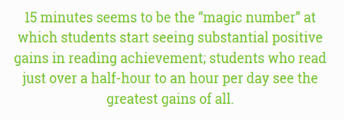
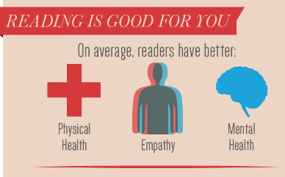
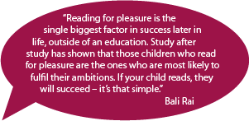
Research snapshots:

Slide 25

Top tips for reading with your child:
Choose a quiet and comfortable space – avoid busy areas where you might get disturbed by other family members.
Make sure you choose a time where you don’t feel rushed.
Ask your child why they chose this book and take an interest.
Become a reading role model yourself – read in front of your child and regularly discuss what you’re reading. Involve the whole family!
Think of an appropriate method of incentivising/rewarding your child for reading at home.
Use appropriate tools for SEND – for example an overlay or reading ruler.
Don’t correct everything.

Slide 26

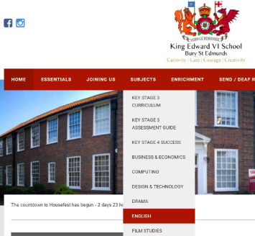
Each unit of work in English has a reading list!
This is available on the school website!

Slide 27

Homework
As well as reading, students will have homework booklets which they can access via Microsoft Teams.
This will give them a series of writing tasks to develop their written literacy skills.

Slide 28


KS3 English Celebrations!
Mr Gaw’s creative writing class
Literary Festival competition winners and Open mic night
Mikey went to the national finals of English-Speaking Union's Shakespeare competition at the Globe Theatre in London
Emily represented the school at the regional Speak Out Challenge final where she had to deliver a two-minute speech on something she was passionate about.

Slide 29
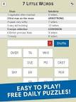



Helpful Online Resources
Reading
Carnegie long list
Newsround
BBC News
The Guardian: Comment is Free (or any other opinion articles)
Vocabulary and Spelling
Membean
General
BBC Bitesize – KS3 English
Handy Free Apps
7 Little Words
Word of the Day
Words with Friends
Wordscape

Slide 30
How to support your child with Maths at Secondary School
Advice from Robin Woodhouse – Head of Maths

Slide 31

Katesha Harrison – Head of Science

Slide 32



Slide 33

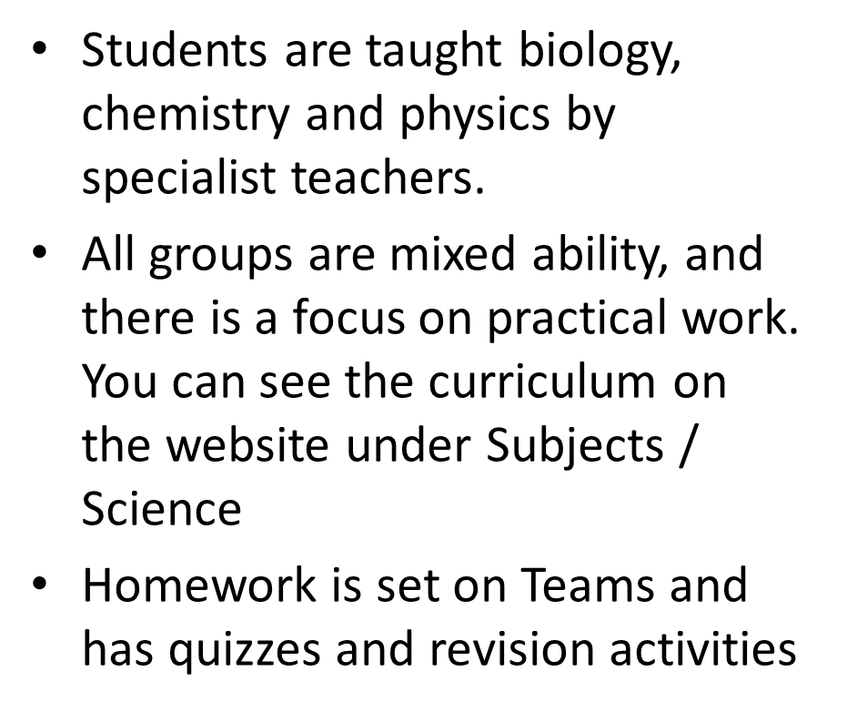
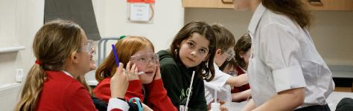
KS3 Science

Slide 34

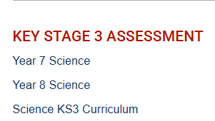

Slide 35


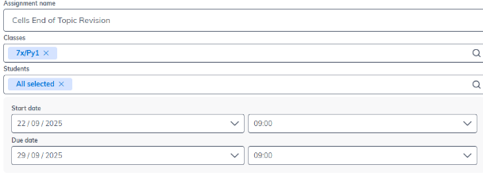

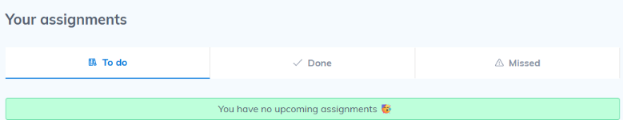

Slide 36
Sue Sweny
Safeguarding Officer

Slide 37


What are the risks of social media for children?
Sending or receiving inappropriate content
Sharing their location
Inappropriate behaviour
Obsessive focus on likes or comments
Over-sharing
Unrealistic sense of body image or reality
Making friends with people they don’t know
Mental health damage

Slide 38






Is your child ready?
The age of your child as well as their developmental stage and
maturity can affect their ability to have a safe and positive experience online.
Minimum age requirements
Development and maturity
What are their social skills like?
How do they deal with negative experiences?
Will they come to you if they need help?

Slide 39
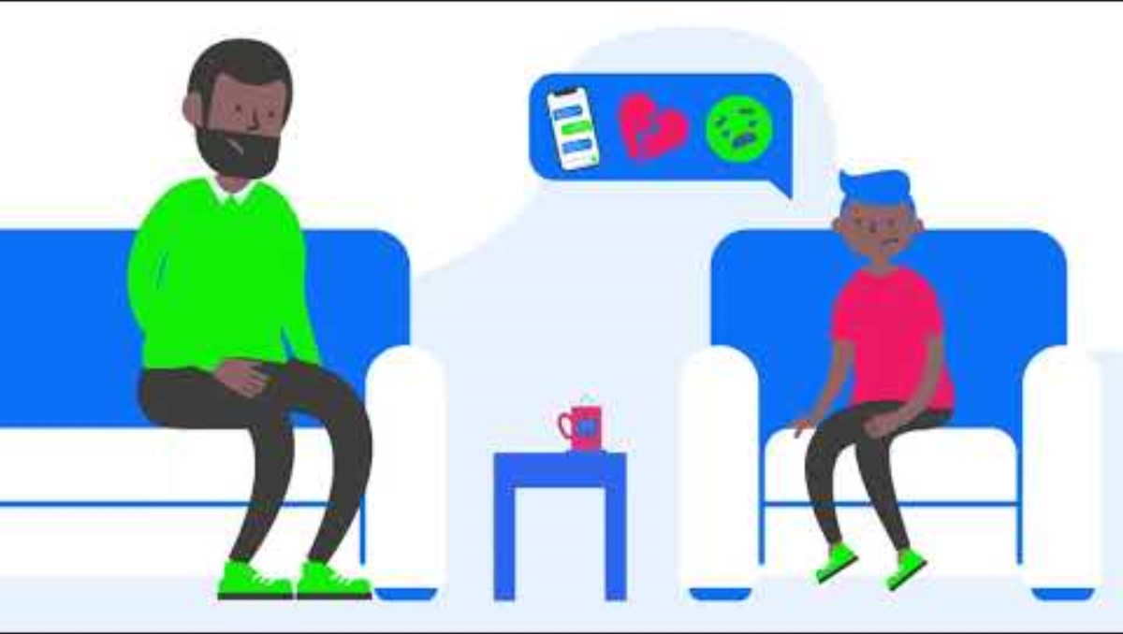

Slide 40






Are you ready?
Check out the social media site or app
Take time to be proactive
Be a great role model
Getting started with social media
Talk honestly with your child
Explore together
Make an agreement

Slide 41
Schools Mental Health Support Team
Sophie Sharp - Senior Education Mental Health Practitioner (EMHP)

Slide 42

Add for MH Team

Slide 43

Add for MH Team

Slide 44

Contacting the SEND team
Katy Farrow - SENCO
fy@king-ed.suffolk.sch.uk
Di White– Assistant SENCO (KS3)
dew@king-ed.suffolk.sch.uk
Jess Lee - Senior Administrator for Learning Support
jle@king-ed.suffolk.sch.uk

Slide 45

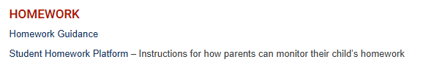
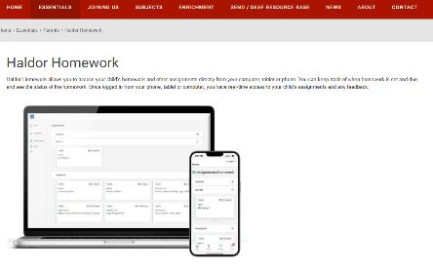
Please use the email address you gave to the school.

Slide 46


Keep in touch
@king-ed.suffolk.sch.uk
Notes:
Explain the different lines of contact and support
Go for assessment information, attendance and behavior notes
Encourage them to contact tutors as the first point of contact (they know their initials, so they know their email address)

Slide 47
Key Dates
25 September | Year 7 Welcome Event
24 October | PD Day – School Closed to Students
27 October | Half- Term
27 November | Year 7 Parents' Evening
4 December | Christmas Carol Service
19 December | Last Day of Term

