Slide 1
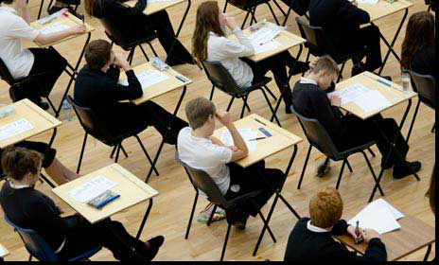
Exams
Important Information, Rules and Regulations
Mock Examinations
June 2025
Mrs Blyth, Examinations Officer

Slide 2
Timetables, seating plans and timings
Timetables
- emailed to your student email, and home, (SH = Dome) please check carefully
- master timetable on school website
Seating plans
- will be put up the day before each exam outside the Lower Hall, in the lobby area, please still check these as there may be last minute seating changes
Meeting area before exams
car park area outside the Lower Hall, or outside your individual room
Timings
Check your timetable and arrive 10 minutes before the start time to line up
end time may be before the end of a lesson
Extra time students
– exams may run after the end of school, you may still use your extra time
if your exam runs into break we will ensure you get a break although it may be shorter than usual

Slide 3
Exam Rules and Regulations
-These Exams will be run under the same rules and conditions as your Summer 2026 GCSE exams.
-Any behaviour that could be interpreted as disruptive or involve cheating could jeopardise these results, and may be reported to the Exam Board. Unacceptable behaviour in mocks will be reported to your Head of Year who will make contact with parents/carers – it is IMPORTANT you get these exams right

Slide 4
The role of the Exams Team and trained Invigilators
To support you through your exams experience, from mocks to your GCSE’s
To ensure the best environment for completing your exams, ensuring there are no other students disturbing your exams in your exam room and that behaviour standards are high throughout and that you follow the rules, so there is no risk of malpractice reports submitted for our students which can result in the loss of marks for one or all papers and subjects in your GCSE’s

Slide 5
Additional important Information that you need to know………….

Slide 6
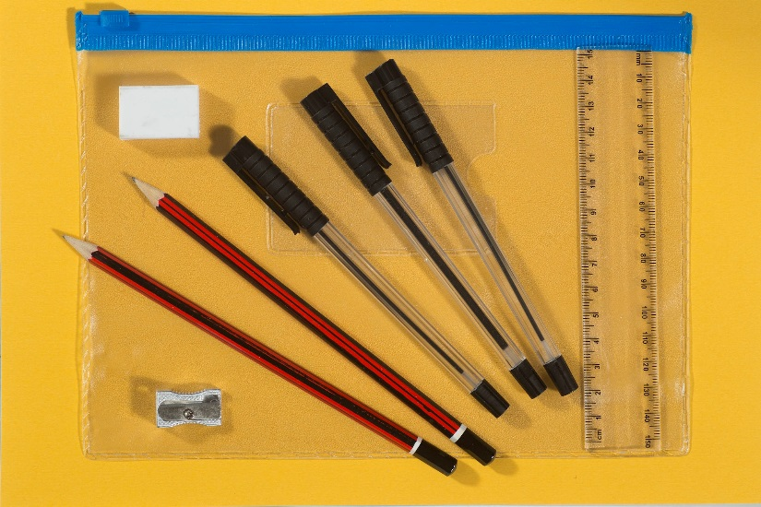
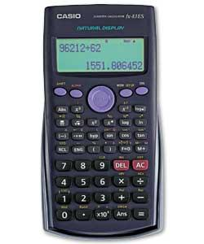

No. 3 – Bring the correct equipment
Only use black pens
Erasable pens are not permitted
Only clear pencil cases are permitted
Clear anything stored in your calculator, and put your lid away in your bag
No notes, revision books, calculator lids/instruction leaflets or any digital equipment or fidget toys unless an authorised exam access arrangement
Remove labels from your water bottle, only clear water allowed

Slide 7



No. 7 – Mobile phones, smart watches, digital watches, iPODS, Fitbits or MP3/4 players
are not permitted
You must not have a mobile phone, any watch, including iwatch (or smartwatch), ipod, Fitbit, MP3/4 player (or any potential technological/web enabled device, including smart glasses) on your person during the exam, please put them in your bag BEFORE entering the exam room.

Slide 8

No. 4 – At the start of the exam
Get everything you need for the exam out of your bag before you enter the exam room. Your bag (with switched off mobile phone, watches etc) must be placed in the allocated area away from your desk
You must enter the exam room in silence
Listen to and follow any instructions given by the invigilator
Check you have the correct paper, but do not open until told to do so
Read the instructions on the front of the exam paper carefully
Fill in your details, including your teacher’s name on the front of the exam paper or answer booklet only when told to do so
Notes:
Pay attention – this may be the last chance to sort out problems before the exam begins

Slide 9
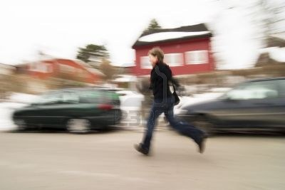
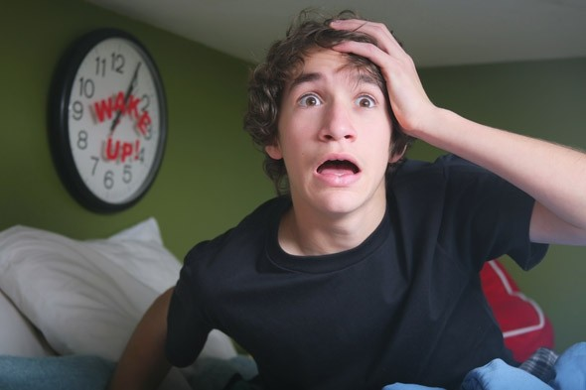
No. 1 – Don’t be late and come prepared
Check your timetable carefully for the start time and the rooming details.
Arrive at least 10 minutes before the start of each exam, with all equipment you need

Slide 10
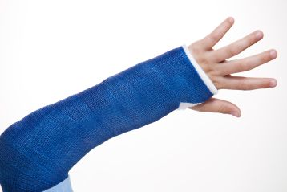

No. 2 – Notify the School if you are unwell or have an injury
If you are ill on the day of your exam your parent or carer must telephone the school and report your absence in the usual way
We may need to make alternative arrangements for you to sit the exam on a different day

Slide 11
Additionally………..
You will be expected to be in the correct school uniform
Toilet breaks will not be allowed
Exam desk labels will include student photos, to help you and invigilators identify your seats more quickly, and to meet exam board guidelines on being able to identify students, and will also show your exam timetable

Slide 12
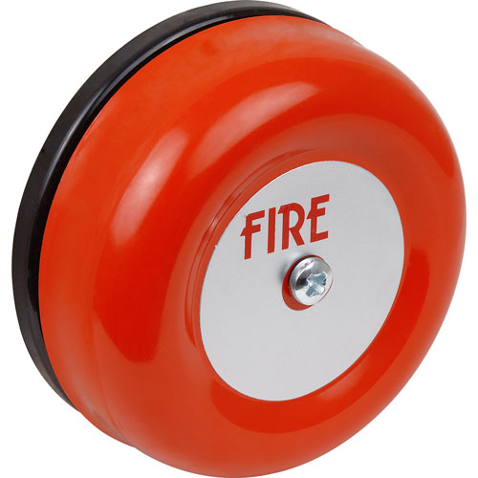
No. 10 – Be aware of the emergency procedures…
Follow the instructions given by the invigilator, your evacuation place will be different to where you would go to on a normal school day. It will be in the rear staff car park, or on the grassed area outside the Lower Hall if you are in a different exam room to the Dome
You must not talk to other candidates
If instructed to evacuate you should leave all personal belongings and exam material in the exam room

Slide 13
Any questions or concerns?
Please come and talk to us in the Exams Office (located near Reception), and don’t leave it until the last minute!

Slide 14
Please watch this video carefully as there is important information you will need to know

