Slide 1
An important message from us…
Soon you will be leaving primary school and joining King Edward VI School. You may be feeling worried and wondering whether you will “fit in”. We want you to know something; everyone will be feeling worried and nervous and that is completely normal. We are here to support you through this transition process and beyond.
You might be worried about what lessons will be like at secondary school and whether you will find it “too hard”. You might be worried about making new friends, having to learn new subjects or find your way around a large school site. Remember, you each have amazing experiences and qualities that you will be bringing to our school. You may be really good at sport, computer games, or debating things. You may be good at thinking about suffering in the world or wanting to do something to save the planet! You may be good at acting, singing or drawing. You may be good at making people laugh. You are probably a really good friend, caring for them when they are sad or listening to others. You may have amazing ideas about innovations!
We are excited to get to know each and every one of you and find out how we can help you make the most of your time with us. You have a special place in our school and we are proud to welcome you as a King Edward VI student.

Slide 2
Transition Evening
2025

Slide 3
Welcome to King Edward VI School
We are very pleased that your child will be joining us in September 2025,
and we trust that their time with us will prove to be both happy and successful

Slide 4
Key Transition Staff
Hannah Scarlett
Ches Ward
Co-Heads of Year 7
year7@king-ed.suffolk.sch.uk
Deri O’Regan
Headteacher
OR@king-ed.suffolk.sch.uk
Tom Spillane
Assistant Headteacher
SP@king-ed.Suffolk.sch.uk
Michaela Organ​
Year 7 Pastoral Support Manager​
ON@king-ed.suffolk.sch.uk​
​
Debbie Dunning
Transition Administrator
transition@king-ed.suffolk.sch.uk

Slide 5
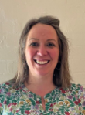
Key SEND Staff
Katy Farrow
SENDCo
fy@king-ed.suffolk.sch.uk
Di White - Assistant SENCo for KS3
dew@king-ed.Suffolk.sch.uk
Jess Lee - Learning Support Senior Administrator
jle@king-ed.suffolk.sch.uk
There will be a presentation in the PAC at 6.30pm by the SEND department.

Slide 6
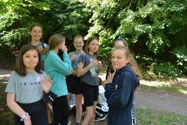
Transition Process at King Edward VI
Transition evening
Liaison with primary schools
Transition days
First day of term – Year 7 only
Success in Year 7 Evening - September
First report in November

Slide 7
Transition Days
DAY 1: Monday 14 July
DAY 2: Tuesday 15 July
These days provide opportunities to:
Meet your tutor group
Meet your pastoral team
Experience a variety of lessons
Meet the other members of Year 7
Find out more about the school
Settle in to school
Find your way around the school
Students will also have an induction at the start of the 2025/26 Academic Year
Parents and Carers will be invited to a Success in Year 7 Evening

Slide 8
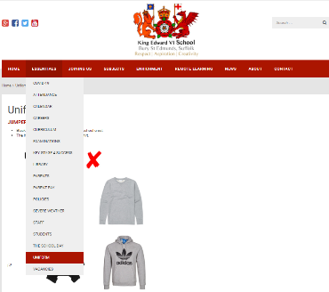
Uniform
Details regarding the school's uniform requirements are available from our school website.
Our branded school items (jumper, shirt, skirt, PE kit) is available via Aubyn Davis. Please view their website for more information www.aubyndavies.co.uk.
Aubyn Davies have requested that parents/carers make appointments if they want to try on and purchase uniform or a click and collect option is available.
We do have a second hand uniform shop in school if you are struggling financially. Please email admin@king-ed.suffolk.sch.uk if you would like to arrange to view the stock.

Slide 9
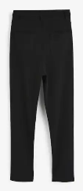
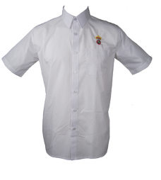
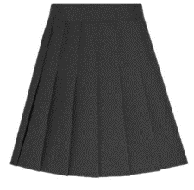
Uniform
School jumper
School shirt
Black tailored trousers (no leggings)
Official school pleated black skirt (optional)

Slide 10
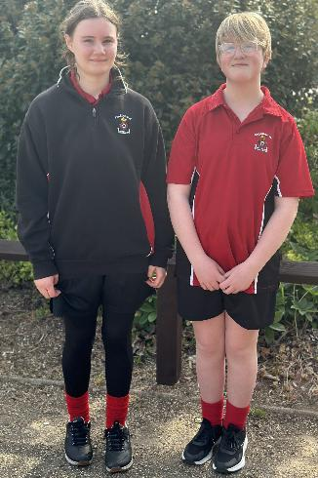
PE Uniform
Compulsory
PE Polo shirt
Plain Black short
Red socks
Astro Trainers or Football boots
Optional
Plain black jogging bottoms
Red, black or white base layer
Black leggings (worn under shorts)
Quarter-zip sweatshirt (new)
Rugby top (old)

Slide 11
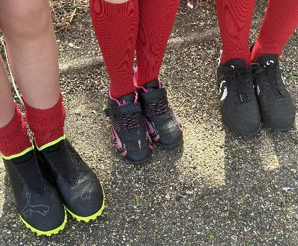
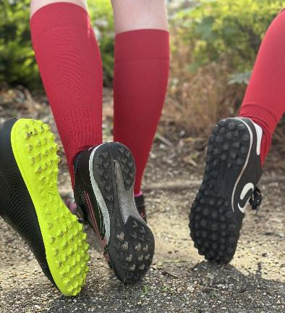
PE Uniform

Slide 12
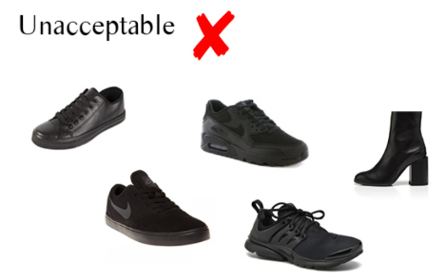
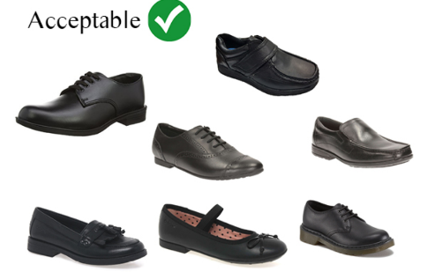
Uniform
Black formal shoes with black sole
Jewellery: 1 metal stud in each ear

Slide 13
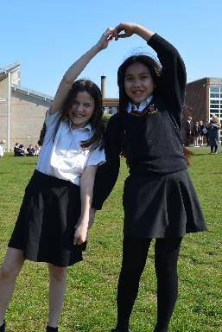
The school day
8.45am – Be onsite at the latest
8.55am – Be at your line up area in tutor group
9.15am – Lesson one
10.30am – Break
10.50am – Lesson two
12.05pm – Lesson three
1.20pm – Lunch
2.20pm – Lesson 4
3.35pm – End of school day and extra curricular clubs begin

Slide 14
Our Curriculum
Year 7 study a broad curriculum
English
Maths
Biology
Chemistry
Physics
History
Geography
Computing
French
Second language
(Year 8 onwards)
Art
Drama
P.E.
Music
Performing Arts
Design Technology
Food & Nutrition
Philosophy & Ethics (RE)
PSHE

Slide 15
Enrichment
We do encourage all year 7s to try at least one club

Slide 16
Music Lessons
Students can sign up for weekly peripatetic music lessons.
Any Music specific queries can be emailed to the music administrator, Mrs Gillian Tye: GNT@king-ed.suffolk.sch.uk
Financial support may be available – please email Mrs Tye to discuss this further.
We offer lessons on the following instruments:
Voice
Piano
Guitar (Acoustic, Electric, Bass Guitar)
Drum kit
Brass - French Horn, Trumpet, Cornet, Trombone, Tuba, Tenor Horn
Woodwind - Flute, Clarinet, Saxophone, Oboe, Bassoon
Strings - Violin, Viola, Cello, Double Bass

Slide 17
Communication: Reports
Parents will receive updates three times per year on effort.
These are in November, February and June. They are broken down into:
Learning behaviour
Effort in classwork
Independent learning (homework)
Most subjects provide 2 attainment grades per year. These are in February and June.
The four rotation subjects are: PSHE, Food, Design & Technology and Performing Arts. These subjects provide an attainment grade after their unit of 10 weeks teaching in November, February, May and July.

Slide 18
Communication: Go4Schools
On a daily basis, we report the following to all parents using Go4Schools:
Attendance to all lessons
Punctuality
Merits and other positive rewards
Negative behaviour points and detentions

Slide 19
Communication: Pastoral Team
Email, phone or arrange a meeting to discuss any challenges with:
Form tutor
Head of Year – Miss Scarlett/Miss Ward
Assistant Headteacher – Mr Spillane
Headteacher – Mr O'Regan

Slide 20
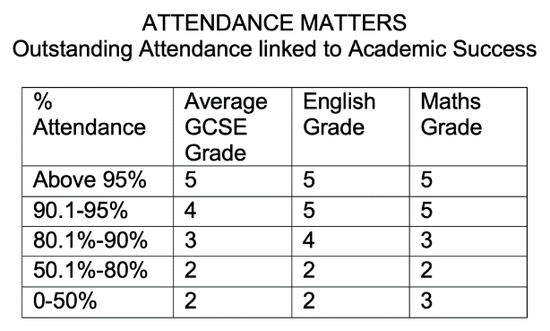
Attendance
School attendance is very important.
We are here to support you if your child is having medical or emotional issues which are affecting their attendance. Please contact us to speak about these.
Please don’t take term time holidays.

Slide 21
Firm on behaviour; gentle on the child
At King Edwards we take a relational approach to behaviour, grounded in the belief that strong, respectful relationships are at the heart of a positive and supportive learning environment. We focus on understanding the reasons behind behaviour and working collaboratively with students and families to make positive choices. Open and honest communication between school and home is key to this approach — when we work together, we can support each child more effectively, helping them to grow not just academically, but socially and emotionally as well.

Slide 22
Mobile Phones
We are a no phones school
“Dumb phones”
Parental controls
Social media

Slide 23
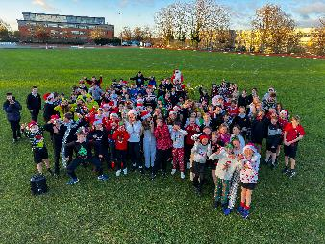
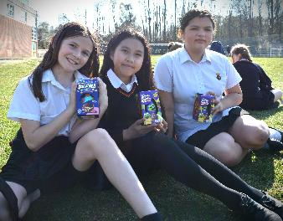
Rewards
Festive Fun Run
Year 7 Disco – September 2025
Easter Egg Hunt

Slide 24
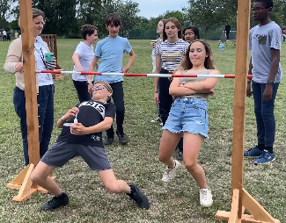
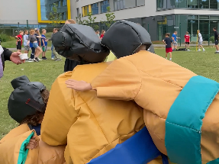
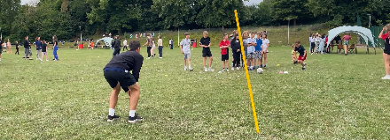
End of Year Reward Trip

Slide 25
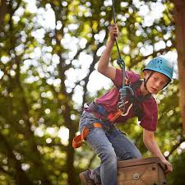
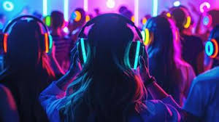
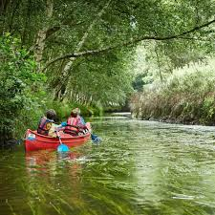
Bawdsey Island Trip July 2026
£120 deposit due end of September

Slide 26
On the Website

Slide 27
On the Website

Slide 28
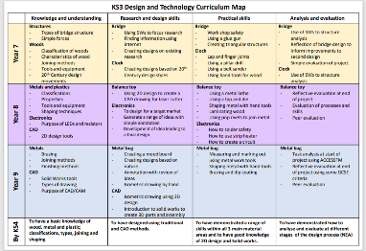
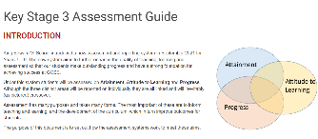
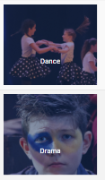
On the Website

Slide 29
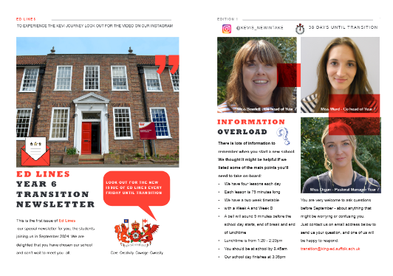
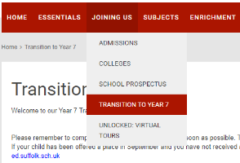
On the Website
We produce digital newsletters, all about transition, which will help students get to know us and our school better.

Slide 30
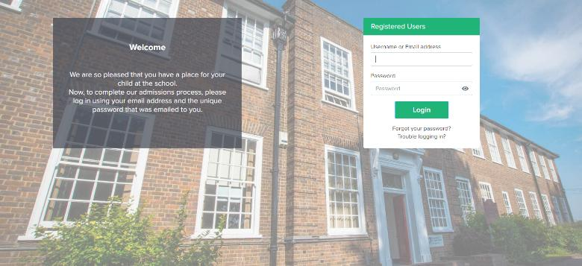

Slide 31
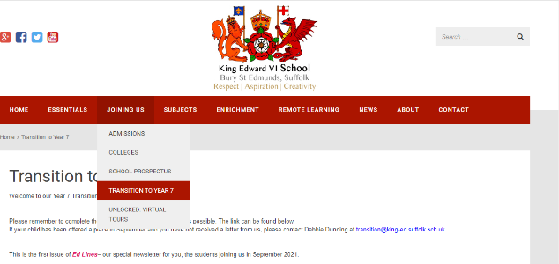
Keeping in Touch
Transition updates will be posted on the
‘Transition to Year 7’ page of our website.

Slide 32
Keeping in Touch
We have a dedicated Transition Instagram page for parents – “Kevis_newintake”.

Slide 33
Keeping in Touch
You can use the email address transition@king-ed.suffolk.sch.uk to ask any questions you may have in relation to starting secondary school.

Slide 34
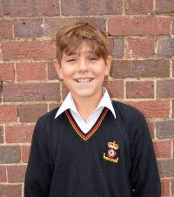
Next Steps
If you haven’t already, login and update admissions+ ASAP
Explore our website
Follow us on Facebook and Instagram
Read the first issue of ‘Ed Lines’
Contact us if you have any questions
Be ready for transition days on 14 and 15 July
King Edward VI School

Slide 35
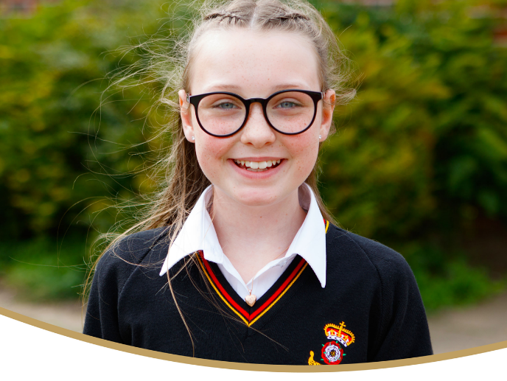
We look forward to seeing you again soon
Thank you for listening

