Slide 1
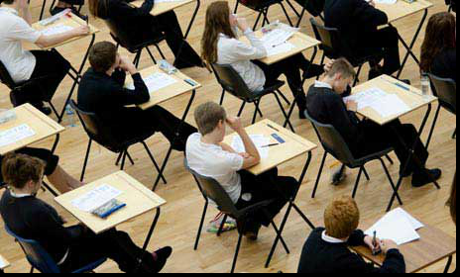
Exams
Summer 2024
Mrs Blyth, Examinations Officer

Slide 2
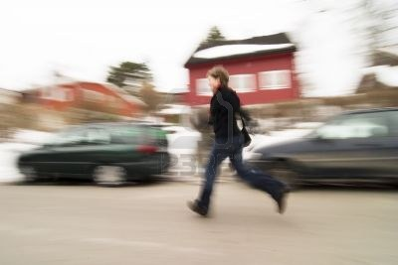
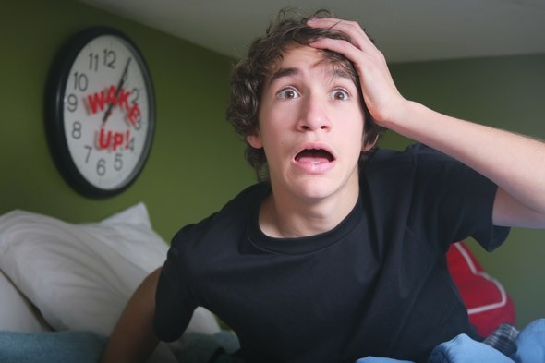
No. 1 – Don’t be late
Check your timetable carefully, take a photo of it on your phone
Check the rooming details on your (seating plans each afternoon for the next days exams outside the Lower hall)
Morning exams start at 9.15am and afternoon exams at 2.00pm
Arrive at least 10 minutes before the start of each exam
Make sure you have a phone number for the school in case of problems

Slide 3
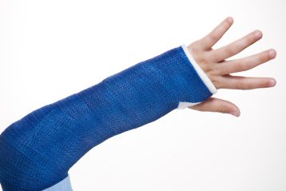
No. 2 – Notify the Exams Officer if you are unwell or have an injury
We may need to make alternative arrangements
If you are ill on the day of your exam your parent or carer must telephone the school and notify the Exams Officer
You will need to complete a self-certification form and you may be asked to provide medical evidence
If you do not have a genuine reason for missing an exam you will be charged for the cost of that exam, £50 per exam

Slide 4
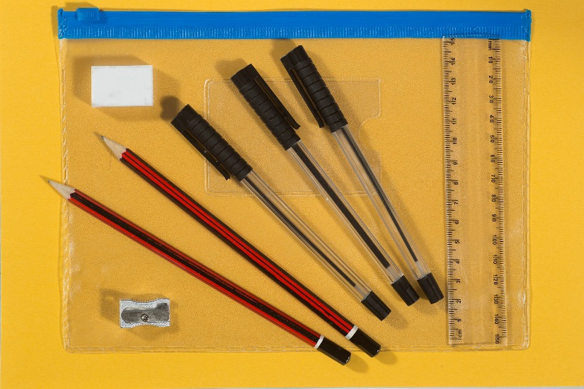
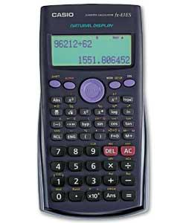
No. 3 – Bring the correct equipment
Only use black pens
Erasable pens are not permitted
Only clear pencil cases are permitted
Clear anything stored in your calculator
No notes, revision books, calculator lids/instruction leaflets or any digital equipment
Remove labels from your water bottle, only clear water allowed

Slide 5
No. 7 – Mobile phones, smart watches, digital watches, iPODS, Fitbits or MP3/4 players
are not permitted
You must not have a mobile phone, iwatch (or smartwatch), ipod, Fitbit, MP3/4 player (or any potential technological/web enabled device) on your person during the exam, please put them in your bag BEFORE entering the exam room. If any devices go off during the exam or you are found with any of the above on your person it will be considered a case of malpractice, must be reported to the Exam board and you may lose marks for some or all of your exams

Slide 6
Behaviour and timekeeping during exams
Do NOT be late for exams – it disturbs all the other students who are already working, and may also mean that if you are every late the exam board may not accept your paper
You MUST be silent from the moment you step inside the exam room, to after you have left, and you must not turn around, make eye contact or try to talk to any other student. If you are seen doing any of the above, it has to be reported as malpractice to the exam board and you may lose some or all of your marks for your exams – over 4500 penalties were issued last year across schools

Slide 7
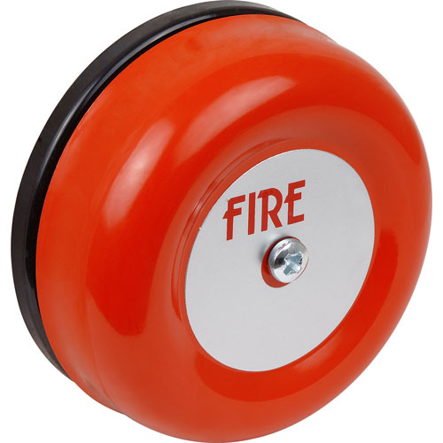
No. 10 – Be aware of the emergency procedures…
Follow the instructions given by the invigilator
You must not talk to other candidates
If instructed to evacuate you should leave all personal belongings and exam material in the exam room
Students in the Dome will evacuate to the back car park, and the smaller rooms will meet outside the Lower Hall on the grass area

Slide 8
Toilet Breaks, Breakfast provision and Lunch Time arrangements
Toilet breaks will only be granted in cases of an emergency, you should ensure you use the facilities just before your exam
If you have an afternoon exam (all exams start at 2pm) you will be allowed to leave session three 5 minutes early to get to the front of the food queue. Sims will show your teacher where you have an afternoon exam
There will be a provision of breakfast available in Ed’s place provided for students sitting an exam on each morning only for those students with a scheduled exam – this should not replace breakfast provided at home, but be supplementary and will consist of fruit pots, pastries, granola pots and squash

Slide 9
Religious Studies and History Paper 2 exams
Both made up of two papers
Handed out together and can be completed in any order, in a total of 1 hour 45 minutes
If on a lap top for either of these exams, pay attention on the day to slightly different instructions

Slide 10
No. 11 – JCQ Designated National Exam Contingency Days for 2024
6 June in the afternoon, 13 June in the afternoon and all day on the 26 June
Should sustained national or local disruption arise during the summer 2024 exam series which leads to the cancellation of any exams they may be rescheduled
You should ensure that you are available to sit exams up to and until 28 June 2024 should the need arise

Slide 11
GCSE Results Day Thursday 22 August 2024

Slide 12
Please now watch this video to remind you again of the rules

Slide 13
Any Questions? Please come and see us in the Exams Office (near Reception) BEFORE the exams begin on 9 May The first exam is now only 9 days away………… GOOD LUCK!!

