Slide 1
King Edward VI School
Year 9 Options
2023

Slide 2
King Edward VI School
Peter Hurry
Assistant Headteacher

Slide 3
What MUST I take?
English 2 GCSEs
Maths 1 GCSE
Science 2 or more GCSEs
PE
Personal Development Programme
Notes:
Science changes – may be given the opportunity to take all three science or a combined course of Core and Applied Science
Some of you already studying GCSE PE, sport leader etc

Slide 4
What may I CHOOSE?
Cultural Learning
Geography
History
Psychology
Sociology
French
Business
Creative Learning
Art
Drama
Music
Film
Studies
Dance
Textiles
Scientific Learning
Engineering
Product Design
Food Preparation
Child Development
Computer Science
Notes:
Science changes – may be given the opportunity to take all three science or a combined course of Core and Applied Science
Some of you already studying GCSE PE, sport leader etc

Slide 5
Choosing courses …
DO think about your strengths and weaknesses
DO choose what you are good at and will enjoy
DON’T choose courses based on your friends or teachers
DO think about your long-term plans

Slide 6
Points to consider
Some subjects can be taken in the Sixth Form even if not taken at GCSE - eg Business
Others MUST be taken at GCSE in order to be taken in the Sixth Form - eg French

Slide 7
Points to consider
Economics -How do the forces of supply and demand allocate resources in macroeconomic and microeconomic situations.
Computer Science - Investigation, design and production of coded solutions to problems
Engineering - The application of Maths and Science to solve practical problems
These are challenging academic courses where a high level of logical and mathematical ability is desirable.

Slide 8
Recent Courses Introduced
Cambridge National Certificate
Child Development
Technical Awards
Engineering
BTEC Tech Award in Performing Arts (Acting)
These are all GCSE equivalent Level 2 course where there is a greater emphasis on internal assessment instead of external exams

Slide 9
Points to consider
Separate Science is taken in core science lessons not as one of your option choices
GCSE PE is one of your option choices. It is no longer taken in core PE time.

Slide 10
English Baccalaureate
In order to obtain the performance measure students have to achieve GCSE level 5 or above in the following subjects:-
English
Mathematics
2 Sciences
A Foreign Language (French, German or Spanish)
A Humanities subject (History or Geography)

Slide 11
Remember …
We cannot guarantee that all courses will run: they depend on numbers
We strongly recommend Languages for most students
We recommend a RANGE of courses, rather than a narrow choice

Slide 12
Who can help?
Your parents
Your tutor & subject teachers
Our Careers Advisor – Angela Hahn
AHN@king-ed.suffolk.sch.uk
Course Finder - Abbeygate Sixth Form College (abbeygatesfc.ac.uk)

Slide 13
This is not a one-size-fits-all curriculum
Block 1
Geography
History
Sociology
Block 2
Art
Photography
Film Studies
Block 3
Engineering
Product Design
Food Prep.
Block 4
PE
French
Spanish
Psychology
Dance
Child Development
German

Slide 14
We give you more freedom of choice
Computer Science
History
French
German
Psychology
Drama
Geography
French
Spanish
Film Studies
Business
Photography
Art
Humanities
Sociology
Engineering

Slide 15
Sims Options Online: How to create a student account
1. You will receive an invitation via your school email from Sims

Slide 16
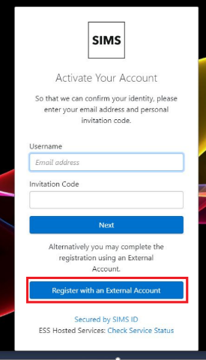

Slide 17
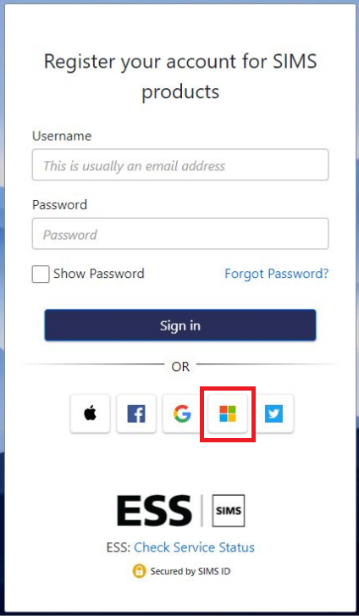

Slide 18
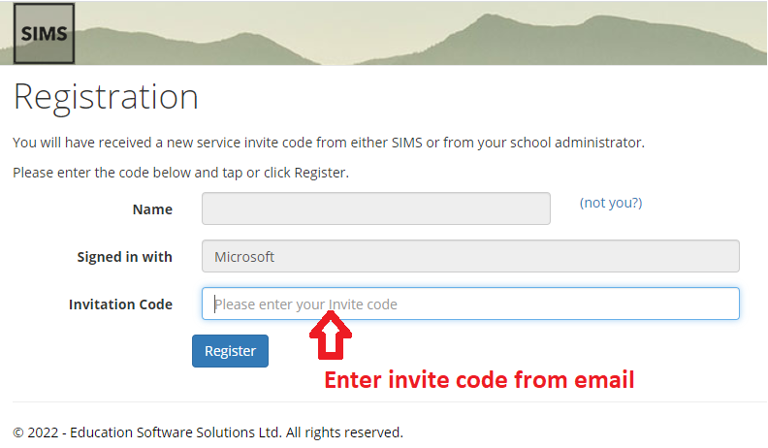
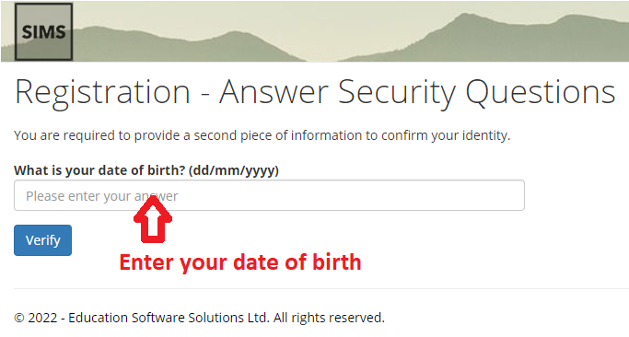

Slide 21
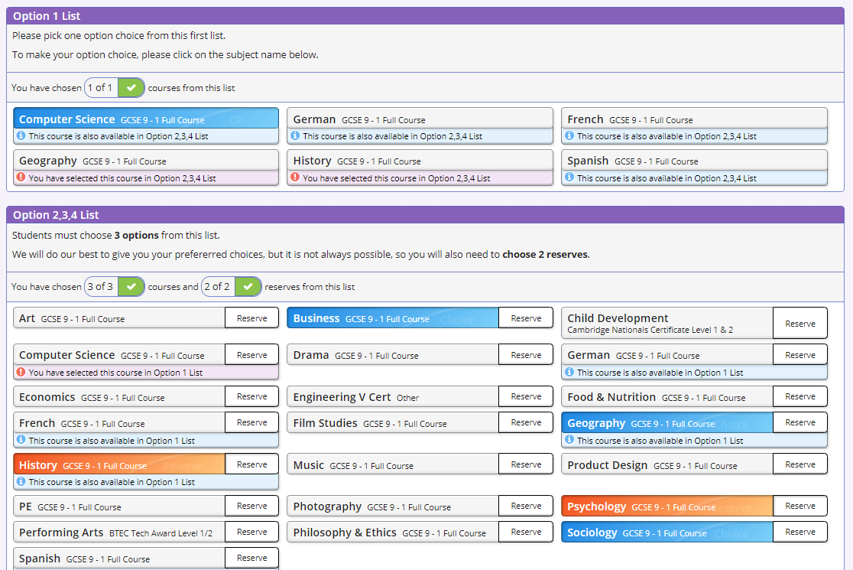

Slide 22
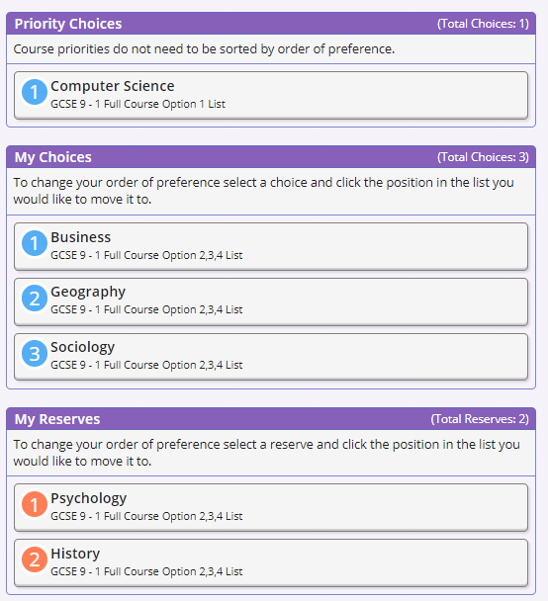

Slide 23
King Edward VI School
Year 9 Options
2023

