Slide 1
2021/22

Slide 2
What is Abbeygate?
An A Level Sixth Form College – over 30 different subjects
Adult working environment
Head of Faculty – every student is allocated to a HoF
Personal Progress Tutor - every student is allocated to a PPT
A host of extra-curricular opportunities
Full support and guidance to help you progress on to your chosen destination

Slide 3
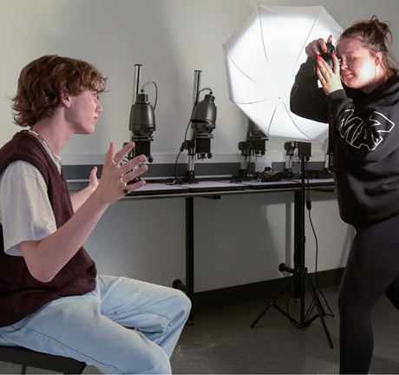
Why Abbeygate?
Excellent results:
72.5% A*-B
91% A*-C
100% A*-E
Amazing Progression:
75% of students went to university
89% of students went to their first choice
Fantastic Facilities:
10 Science Labs, 10 Art Labs, 8 music practice rooms, Drama and Dance Studios…

Slide 4
A typical day at Abbeygate SFC
9:15- 10:30
Lesson 1 – Psychology
10:45- 12:00
Lesson 2 – Biology
12:15- 1:30
Lesson 3 – Study Session
1:30- 2:20
Lunch – Table Tennis Club
2:20- 3:35
Lesson 4 - Art

Slide 6
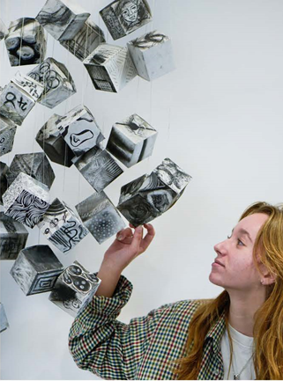
Entry Requirements
A minimum of 5 GCSE’s grade 4-9
An average GCSE score of 5.5 if you wish to study a STEM programme e.g. Biology
Subject specific entry requirements – please check them
We work together, in partnership, to get you to where you want to go
Do the best you can and give yourself options

Slide 7
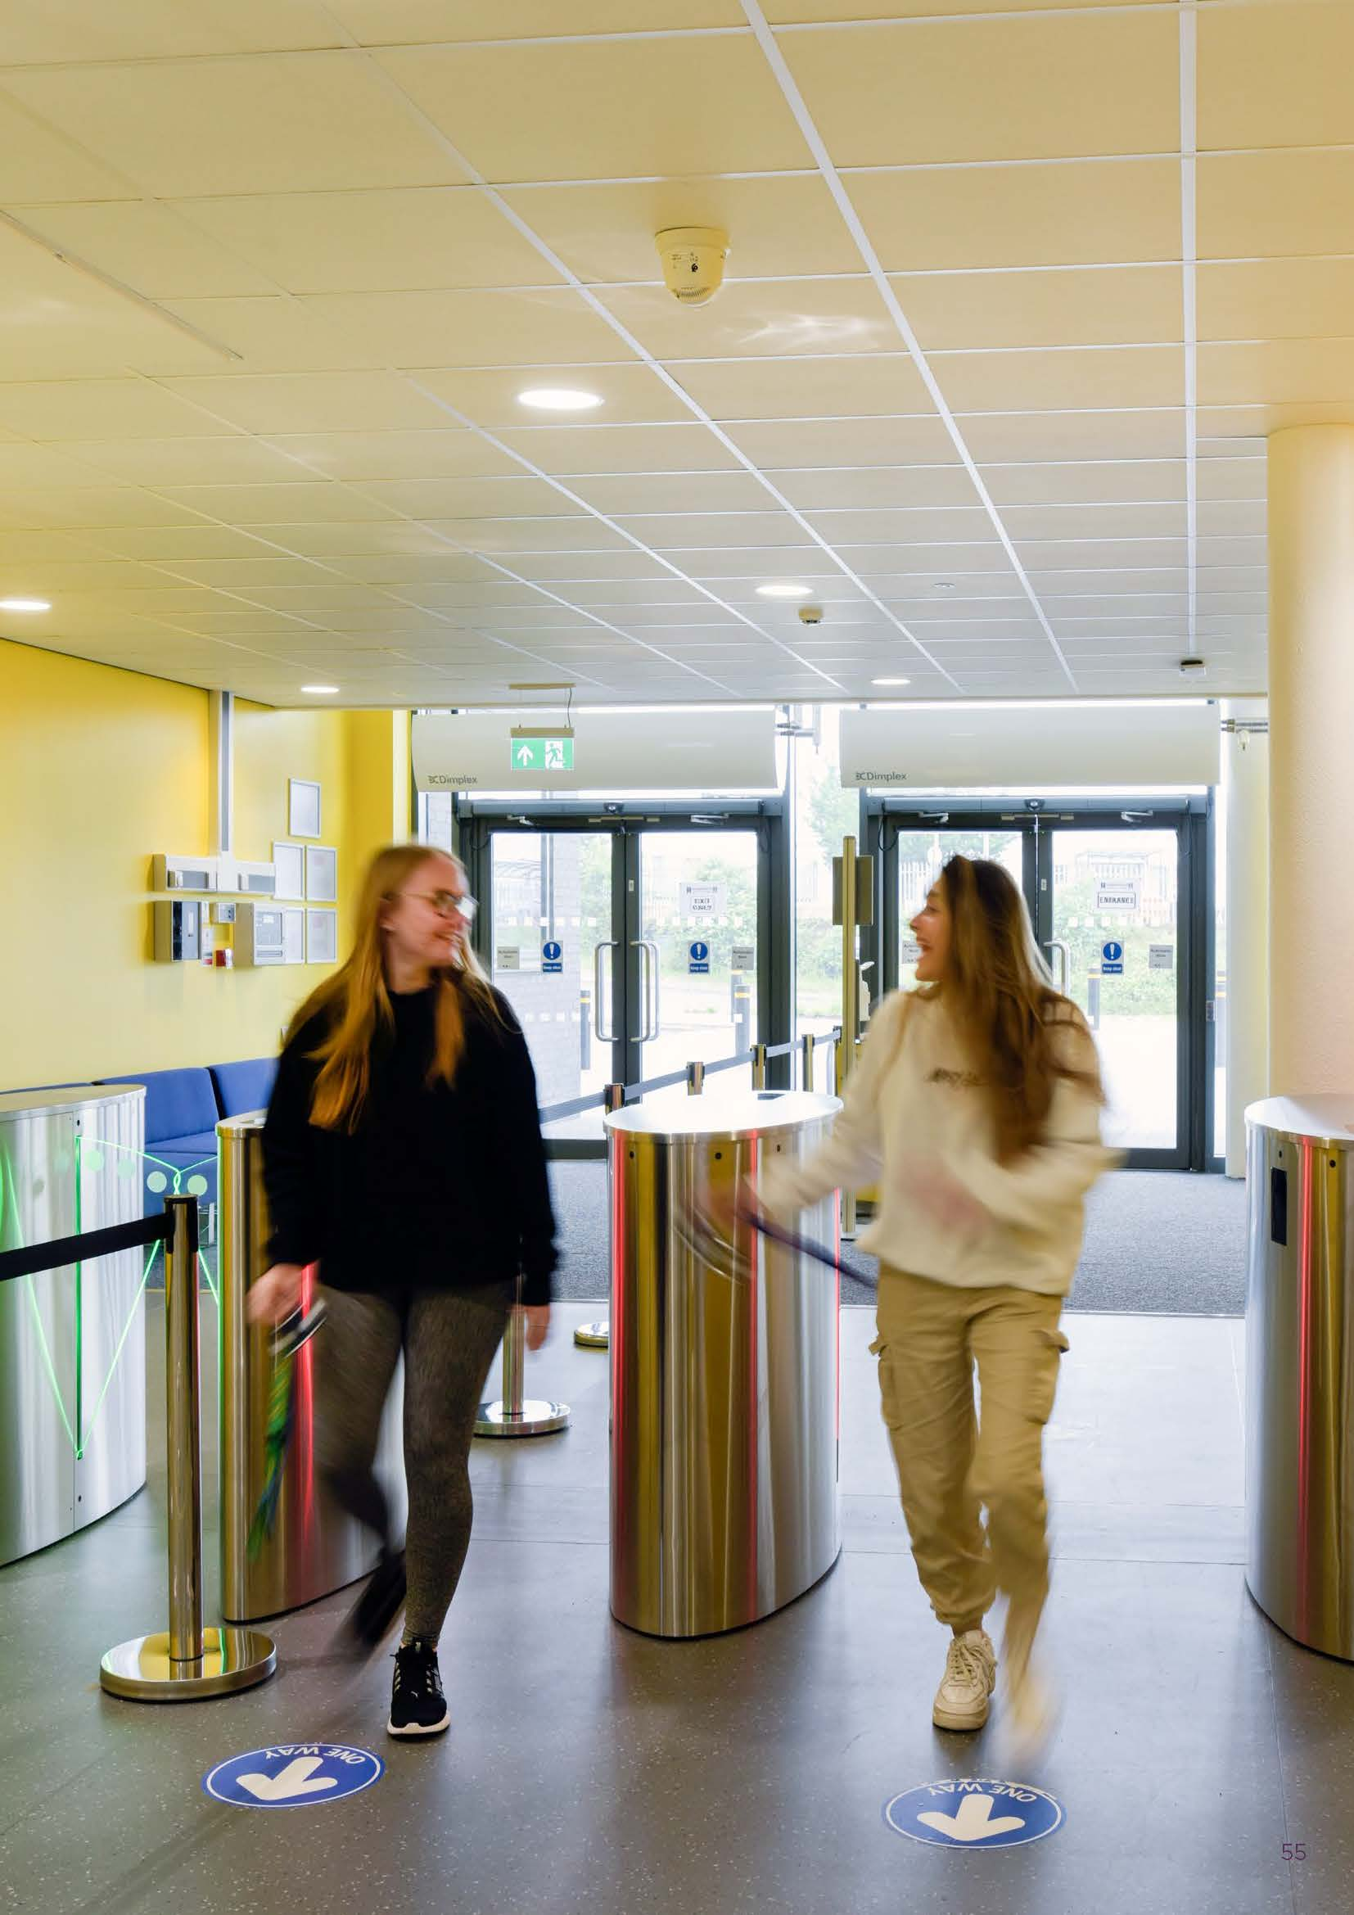

Slide 8
Getting to Abbeygate

Slide 10
Website: www.abbeygatesfc.ac.uk
E mail: info@abbeygatesfc.ac.uk
Tel: 01284 636 501
Follow us…….

